Slide 1
Introduction to FHIR® for Research
National Institutes of Health (NIH),
Office of the Director (OD),
Office of Data Science Strategy (ODSS)
May 2, 2023

Slide 2
Webinar overview
Part 1: Introduction to FHIR® for Research (40 minutes) Learning objectives
Understand FHIR®’s high level characteristics and how they are relevant for research
Identify possible research applications for FHIR®
Know the reasons why FHIR® has been broadly adopted in health IT, and how this impacts FHIR®’s research applications
Understand how FHIR® fits into the ecosystem of other standards/data models
Part 2: FHIR® for Research Technical Overview (35 minutes) Learning objectives:
Understand how FHIR® handles medical terminology to improve semantic interoperability
Understand FHIR®’s approach to representing data with Resources, constraining rules, and extensions
Understand FHIR®’s approach to accessing data via the FHIR® API

Slide 3
Part 1: Introduction to FHIR® for Research
3

Slide 4

The HL7® FHIR® Standard
FHIR® is a standard for exchanging health information electronically
Standards establish a common language and process for all health information technology (IT) systems to communicate, allowing information to be shared seamlessly and efficiently
F
H
I
R
– Fast (to design & implement)
– Healthcare
– Interoperability
– Resources (building blocks)
FHIR® is fast, efficient, and flexible
FREE to use, open standard
“Resources” → Solutions built from modular components called
Customization is built into FHIR’s design through extensions and profiling
4

Slide 5
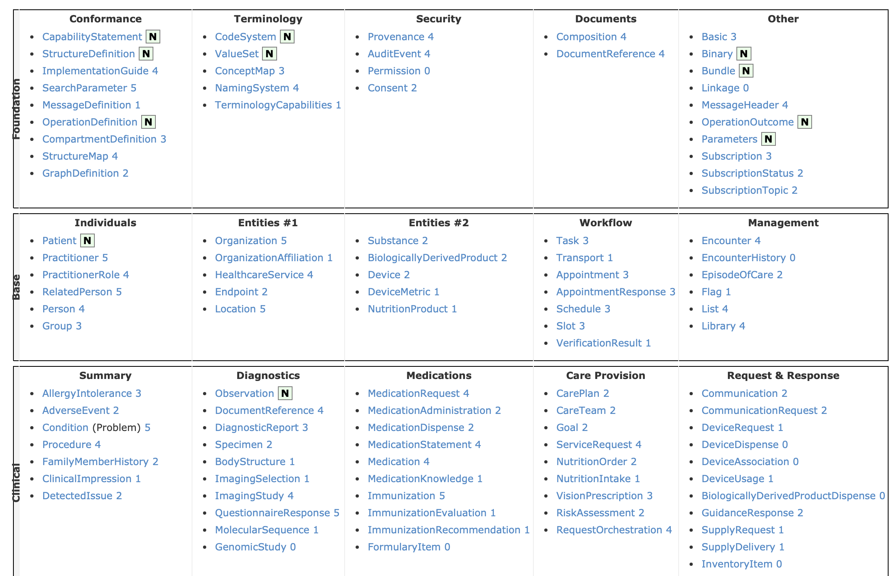
FHIR® R5 Resources (some)
https://hl7.org/fhir/r5/resourcelist.html

Slide 6
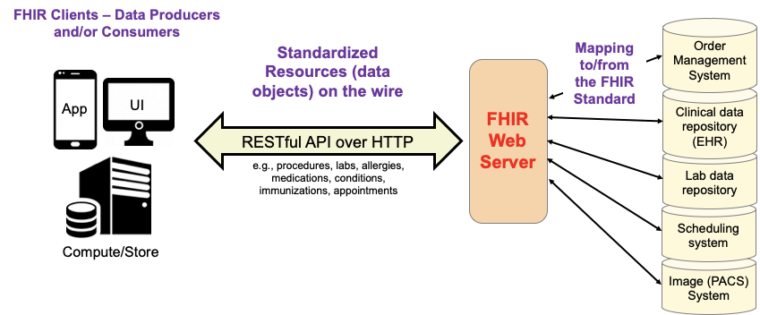
FHIR® Information Flow
PACS – Picture Archive and Communication System
6

Slide 7

Genesis of FHIR®
The Catalyst
HL7 V2 is a point-to-point messaging standard that is over 30 years old
HL7 V3 is very complex, not widely implemented
Pressure to broaden scope of data sharing
More flexible sharing across institutions, borders, domains
Mobile & cloud-based applications
The Benefits of HL7 FHIR®
Promotes cross-industry standards
Uses the same technologies already used across the tech industry
JSON and XML
HTTPS and RESTful interfaces
OAuth2 and OpenID Connect
Supported by existing software tools
Easier to understand by technical end-users
7

Slide 8
Timeline of FHIR® releases
Aug. 2011
First release
Released as Draft Standard for Trial Use (DSTU) standard
Oct. 2015
FHIR® R2
Standard for Trial Use
Apr. 2017
FHIR® R3
Standard for Trial Use
Dec. 2018
FHIR® R4 (current)
First release with some Normative resources
Mar. 2023
FHIR® R5
More Normative resources and new features
Sep. 2014
First draft published on Grahame Grieve’s blog
Note: R2, R3, R4, and R5 are updated versions of the FHIR® standard
8

Slide 9
FHIR® for Research Examples
9

Slide 10
Published Research Using FHIR® Examples
Clinical trial case report forms
Cheng, A.C. et al. (2023) ‘Evaluating automated electronic case report form data entry from electronic health records’, Journal of Clinical and Translational Science, 7(1), p. e29. Available at: https://doi.org/10.1017/cts.2022.514.
Portable phenotyping for cohort definition
Brandt, P.S. et al. (2022) ‘Design and validation of a FHIR-based EHR-driven phenotyping toolbox’, Journal of the American Medical Informatics Association: JAMIA, 29(9), pp. 1449–1460. Available at: https://doi.org/10.1093/jamia/ocac063.
Integrate patient-reported data into an EHR
Lobach, D.F. et al. (2022) ‘Integrating a Patient Engagement App into an Electronic Health Record-Enabled Workflow Using Interoperability Standards’, Applied Clinical Informatics, 13(5), pp. 1163–1171. Available at: https://doi.org/10.1055/s-0042-1758736.
Clinical decision support integration into EHRs
Tarumi, S. et al. (2021) ‘Leveraging Artificial Intelligence to Improve Chronic Disease Care: Methods and Application to Pharmacotherapy Decision Support for Type-2 Diabetes Mellitus’, Methods of Information in Medicine, 60(S 01), pp. e32–e43. Available at: https://doi.org/10.1055/s-0041-1728757.
Links to references: https://purl.org/fhir-for-research/2023-05-refs

Slide 11
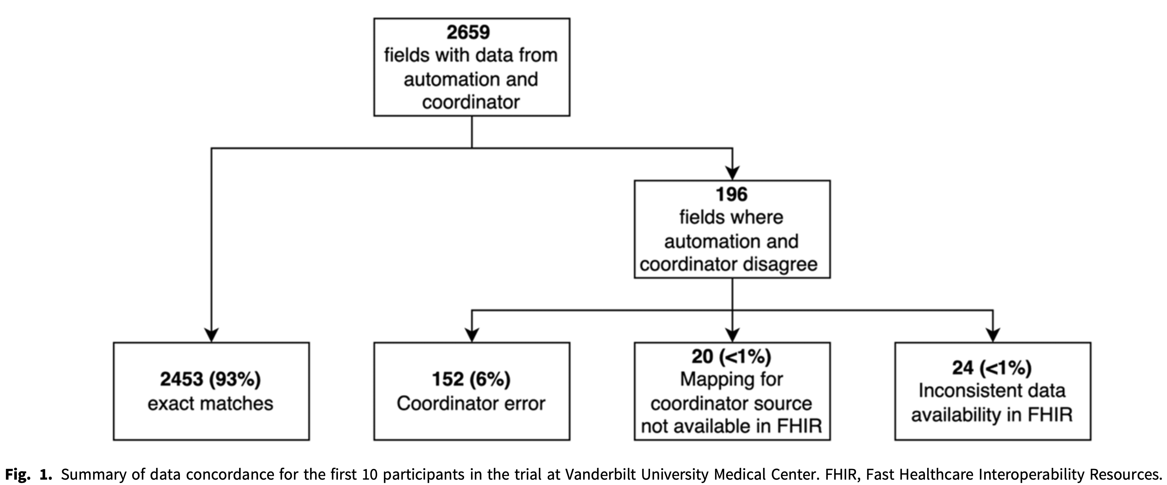
Clinical Trial Case Report Forms
Cheng 2023:
EHR to CRF using FHIR® for 40 patients in COVID trial at Vanderbilt
FHIR® populated 10,081/11,952 (84%) of values with 89% concordance with human entry (often due to data entry error)
Cheng, A.C. et al. (2023) ‘Evaluating automated electronic case report form data entry from electronic health records’, Journal of Clinical and Translational Science, 7(1), p. e29. Available at: https://doi.org/10.1017/cts.2022.514.

Slide 12
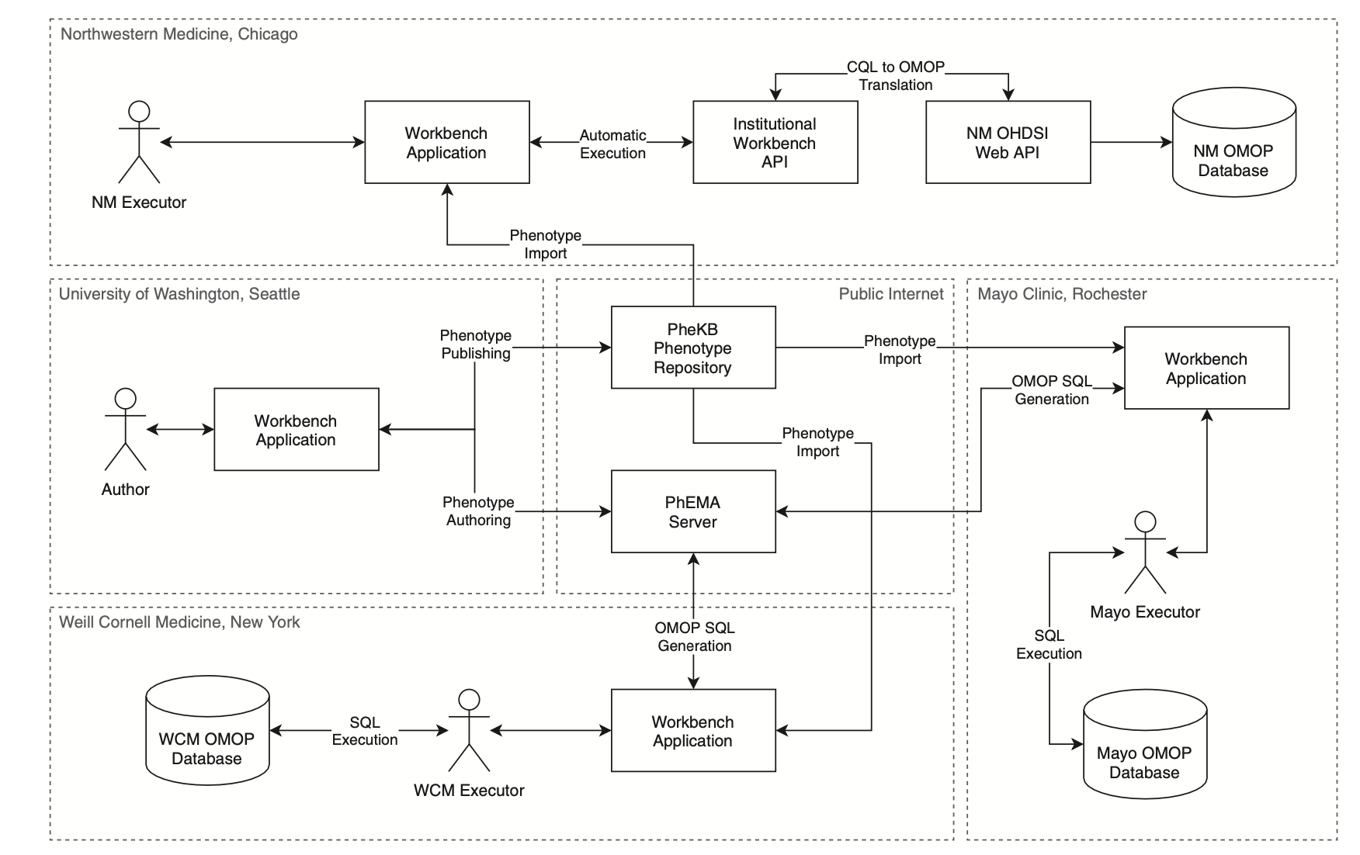
Portable Phenotyping for Cohort Definitions
Brandt 2022:
FHIR®/CQL phenotype definitions
Validated at 3 institutions (Mayo, Northwestern, Weill Cornell)
Used OMOP with FHIR® /CQL → OMOP query translation tool
Leverages existing FHIR® /CQL → [other] mappings
(enlarged on next slide)
Brandt, P.S. et al. (2022) ‘Design and validation of a FHIR-based EHR-driven phenotyping toolbox’, Journal of the American Medical Informatics Association: JAMIA, 29(9), pp. 1449–1460. Available at: https://doi.org/10.1093/jamia/ocac063.

Slide 13
Brandt 2022

Slide 14
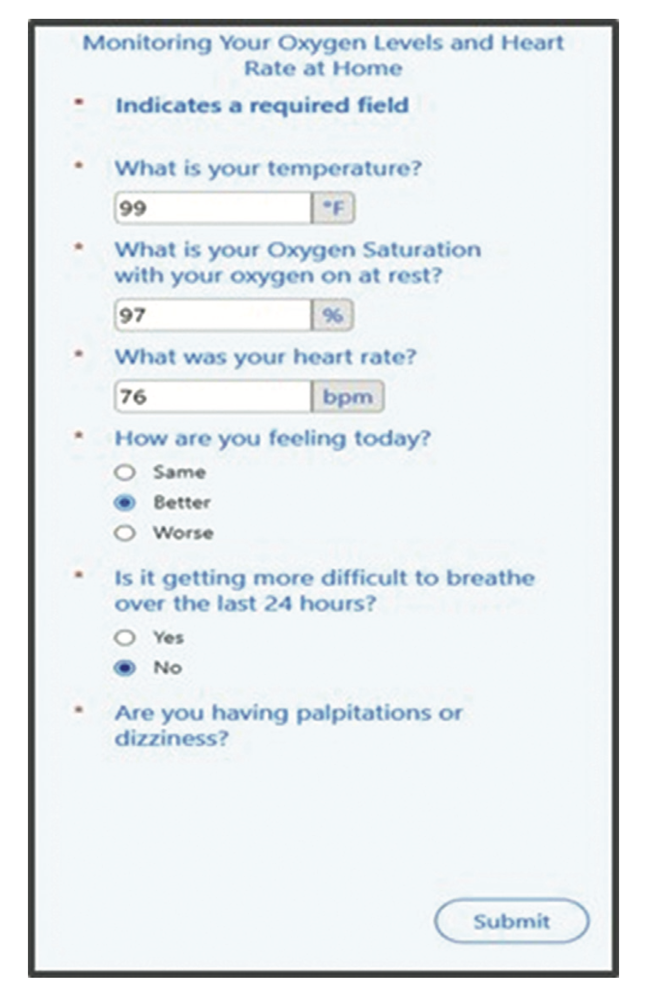
Integrate Patient-Reported Data
Lobach 2022:
Integrated patient mobile application for COVD-19 symptom tracking with Yale EHR
Successfully recorded patient-reported data (e.g. oxygen saturation) into EHR
Paper discusses IT challenges and their solutions
Lobach, D.F. et al. (2022) ‘Integrating a Patient Engagement App into an Electronic Health Record-Enabled Workflow Using Interoperability Standards’, Applied Clinical Informatics, 13(5), pp. 1163–1171. Available at: https://doi.org/10.1055/s-0042-1758736.

Slide 15
Clinical Decision Support (CDS)
Tarumi 2021:
AI predicted likelihood of alternate treatment strategy success for T2DM
CDS recommendations provided via SMART on FHIR® integration with EHR (Univ. of Utah)
T2DM = type-2 diabetes mellitus
Tarumi, S. et al. (2021) ‘Leveraging Artificial Intelligence to Improve Chronic Disease Care: Methods and Application to Pharmacotherapy Decision Support for Type-2 Diabetes Mellitus’, Methods of Information in Medicine, 60(S 01), pp. e32–e43. Available at: https://doi.org/10.1055/s-0041-1728757.

Slide 16
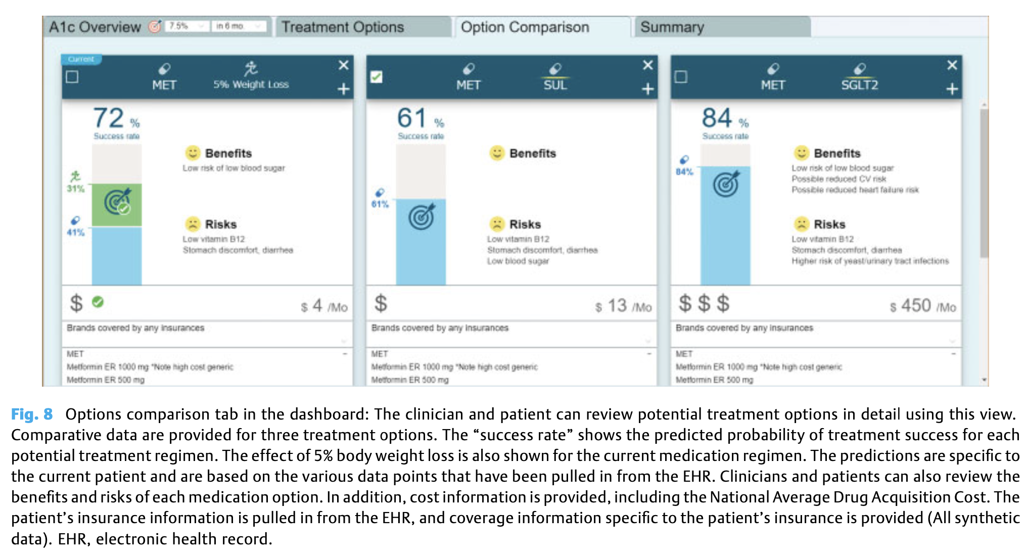
Tarumi 2021

Slide 17
Additional References of Interest
Clinical trial case report forms: Zong, N. et al. (2021) ‘Modeling cancer clinical trials using HL7 FHIR to support downstream applications: A case study with colorectal cancer data’, International Journal of Medical Informatics, 145, p. 104308. Available at: https://doi.org/10.1016/j.ijmedinf.2020.104308.
Patient data: Wesley, D.B. et al. (2021) ‘A novel application of SMART on FHIR architecture for interoperable and scalable integration of patient-reported outcome data with electronic health records’, Journal of the American Medical Informatics Association : JAMIA, 28(10), pp. 2220–2225. Available at: https://doi.org/10.1093/jamia/ocab110.
CDS using FHIR® (review): Strasberg, H.R. et al. (2021) ‘Contemporary clinical decision support standards using Health Level Seven International Fast Healthcare Interoperability Resources’, Journal of the American Medical Informatics Association : JAMIA, 28(8), pp. 1796–1806. Available at: https://doi.org/10.1093/jamia/ocab070.

Slide 18

All References:
https://purl.org/fhir-for-research/2023-05-refs

Slide 19
Current State of FHIR® Adoption
19

Slide 20
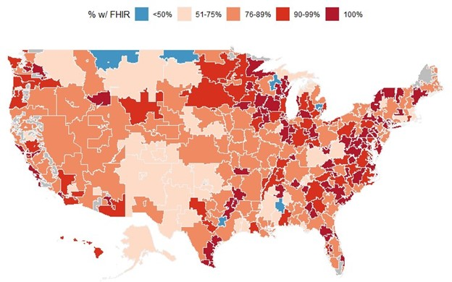
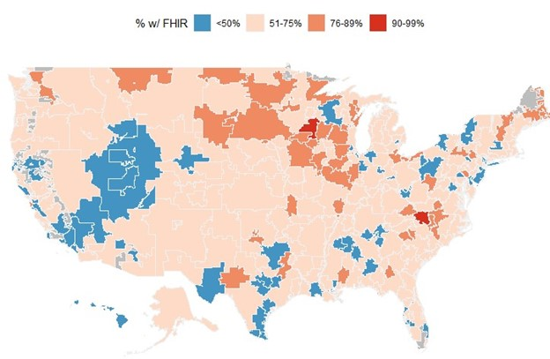
As a Researcher, this is where your FHIR® data might come from [2019 data]…
https://www.healthit.gov/buzz-blog/health-it/the-heat-is-on-us-caught-fhir-in-2019
Hospitals
Clinicians
87% of hospitals and 69% of MIPS eligible clinicians use EHRs certified to HL7 FHIR®
Source: https://www.healthit.gov/buzz-blog/interoperability/heat-wave-the-u-s-is-poised-to-catch-fhir-in-2019
20

Slide 21
Driving FHIR® Adoption
ONC 21st Century Cures Act (“Cures Act”)
ONC = The Office of the National Coordinator for Health Information Technology, https://healthit.gov
The Cures Act supports seamless and secure access to health information
As part of this, ONC added interoperability criteria to the existing 2015 Health IT Certification Program
Health IT Certification Program is voluntary, but CMS provides a financial incentive (https://www.cms.gov/Regulations-and-Guidance/Legislation/EHRIncentivePrograms/Certification)

Slide 22
2016: 21st Century Cures Act
Sec. 4002. Transparent Reporting on Usability, Security, and Functionality
Certification requires publishing an API
Sec. 4003. Interoperability
Has ONC assist public-private partnerships to create a “trusted exchange framework, including a common agreement among health information networks nationally”
Sec. 4004. Information Blocking
Defines “information blocking” as a practice that (accept as required by law) “is likely to interfere with, prevent, or materially discourage access, exchange, or use of health information”
Sec. 4005. Leveraging Electronic Health Records to Improve Patient Care
Sec. 4006. Empowering Patients and Improving Patient Access to their Electronic Health Information
http://www.himss.org/library/summary-key-health-it-provisions-21st-century-act-passed-house-11302016
22

Slide 23
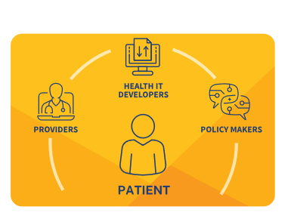
A Patient-Centric Approach to Interoperability
From HealthIT.gov:
The Patient at the Center
When this Cures Act Final Rule is fully implemented, putting the patient first means that health information technology should:
Enable patients to make choices that work for them by increasing transparency into the cost and outcomes of care
Allow patients to shop for and understand their options in getting medical care
Provide patients with convenient, easy access and visualizations of health information through smartphone apps
Support an “app economy” that provides innovation and choice to patients, physicians, hospitals, payers, and employers
https://www.healthit.gov/curesrule/
23

Slide 24

Timeline for Implementation of Interoperability Standards
USCDI – 4/2021
FHIR® API – 12/2022
FHIR® Bulk Export – 12/2023
24

Slide 25

US FHIR® Core Profile
Profiles 23 FHIR® resources specifically for the US healthcare market
US Core is driven by and interacts with United States Core Data for Interoperability (USCDI)
USCDI is a standardized set of health data for nationwide, interoperable health information exchange
ONC Cures Act requires as a condition of certification that EHRs adopt the USCDI standard, a “standardized API for patient and population services,” which includes an initial set of 16 data classes comprised of 52 data elements
USCDI Data Element: most granular level at which a piece of data is represented for exchange
USCDI Data Class: data elements grouped by common theme or use case
Initial US Core ballot occurred in 2021 and subsequent ballots to update US Core occurs every January beginning in 2022
US-based FHIR® Implementation Guides should use US Core Profiles as building blocks when possible
25

Slide 26
FHIR’s Fit With Other Standards
26

Slide 27

Evolution of Healthcare Standards
HL7 V2
Allows for simple transfer of information
Point-to-point messaging
More complex interactions are not supported
HL7 V3 / Clinical Document Architecture (CDA)
Intended to enable next level of complexity
Interface specification based on Simple Object Access Protocol (SOAP) and XML
Specifies the content of the data exchanged between healthcare applications, and how the exchange is implemented and managed
Very complex - difficult to implement and requires tremendous technical expertise
HL7 FHIR®
Most commonly used standard in healthcare today
Specification based on current mobile web technologies
Developers can read documentation and get up to speed quickly
Messaging, Documents, and Query
Easily create rich and complex applications, particularly mobile applications

Slide 28
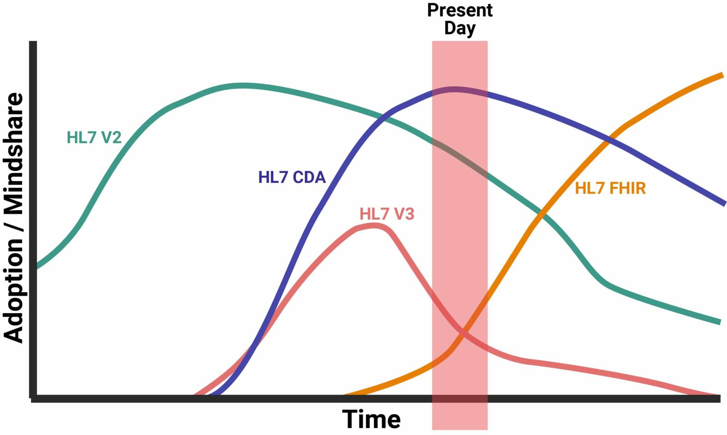
FHIR® vs. Other Standards
Clinical Document Architecture
https://www.intersystems.com/fhir/
28

Slide 29
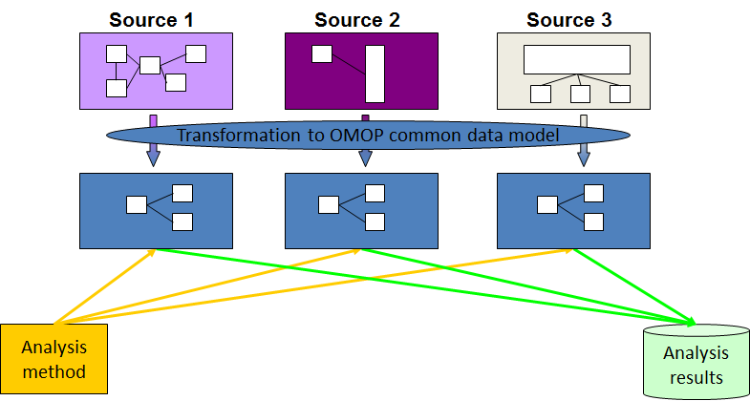

OMOP
Observational Health Data Sciences and Informatics (OHDSI)
Observation Medical Outcomes Partnership (OMOP)
OMOP Common Data Model (CDM)
https://covid.cd2h.org/n3c
https://www.ohdsi.org/data-standardization/the-common-data-model/

Slide 30

Example: OMOPonFHIR
Georgia Tech’s FHIR® and OMOP CDM mapping platform
Supports mapping between versions of FHIR® and OMOP CDM
Bidirectional read and write capabilities for FHIR® versions DSTU2, STU3, R4 and OMOP CDM v.5.3.1 and v6.0
OMOP to FHIR®
Retrieval of relational data stored in OMOP CDM as FHIR® Resources
Standard FHIR® queries are translated into SQL queries to be performed on the OMOP CDM database
The data is mapped and converted into FHIR® Resources
FHIR® to OMOP
Allows users to post FHIR® Resources to the server
Resources are mapped and written to the OMOP CDM relational database
https://omoponfhir.org
30

Slide 31

Summary
FHIR® is an open standard for exchanging health data that is widely adopted and has untapped potential to enable/accelerate research.
FHIR® may be useful for research touching EHR data
Integration with clinical workflows (CDS, patient-reported data)
Extracting data (e.g., clinical trial case report forms)
Phenotyping (e.g., multi-site cohort building)
FHIR® is overtaking older standard (V2, V3) in adoption
FHIR® peacefully coexists with research CDMs like OMOP
More information: https://purl.org/fhir-for-research/web

Slide 32
Part 2: FHIR® for Research Technical Overview
32

Slide 33
Outline
Terminology and FHIR® [10 min]
FHIR® resources and profiles [15 min]
Using FHIR® with other systems [10 min]

Slide 34
Terminology and FHIR®
34

Slide 35
Importance of Terminology
Using standard terminologies allows researchers to access, exchange, organize, and utilize health data in a consistent and reliable way.
e.g., standardized terminology to identify conditions in a problem list → automated cohort building based on presence/absence of conditions
Common code systems: LOINC, SNOMED CT, ICD, RxNorm
FHIR® supports:
Defining code systems
Mapping between them
“Binding” a FHIR® data element to a specific subset of concepts from selected code systems

Slide 36
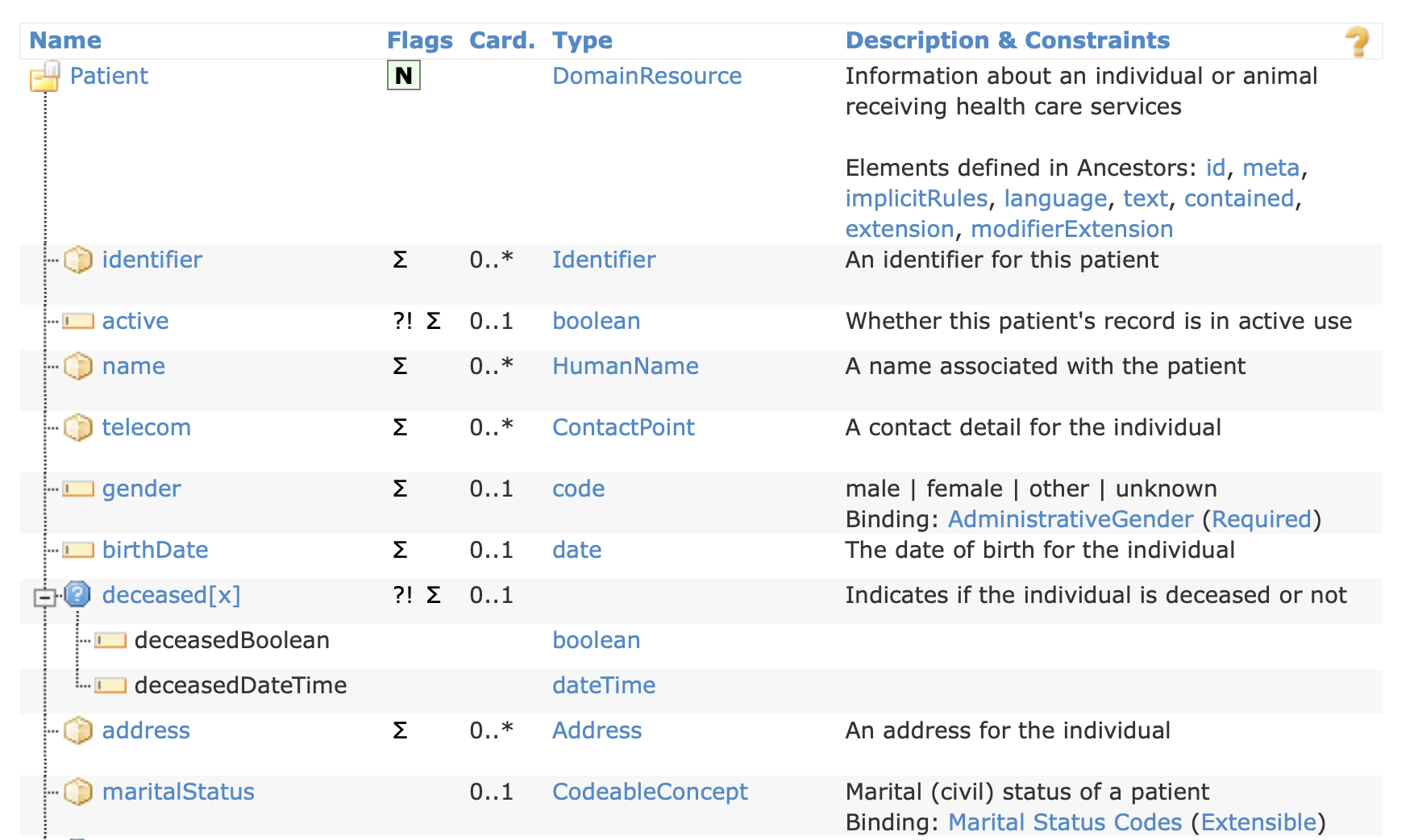
Example: Patients in FHIR®
https://www.hl7.org/fhir/R5/patient.html
36

Slide 37
Patient.maritalStatus binding
https://www.hl7.org/fhir/R5/valueset-marital-status.html:
Code | Display | Definition | System
A | Annulled | Marriage contract has been declared null and to not have existed | http://terminology.hl7.org/CodeSystem/v3-MaritalStatus
D | Divorced | Marriage contract has been declared dissolved and inactive | http://terminology.hl7.org/CodeSystem/v3-MaritalStatus
I | Interlocutory | Subject to an Interlocutory Decree. | http://terminology.hl7.org/CodeSystem/v3-MaritalStatus
L | Legally Separated |  | http://terminology.hl7.org/CodeSystem/v3-MaritalStatus
M | Married | A current marriage contract is active | http://terminology.hl7.org/CodeSystem/v3-MaritalStatus
… | … | … | …

Slide 38
Patient.maritalStatus, continued
FHIR® identifies
“Value set” list of possible codes: https://www.hl7.org/fhir/valueset-marital-status.html
“Code system(s)” that these codes come from: http://terminology.hl7.org/CodeSystem/v3-MaritalStatus or http://terminology.hl7.org/CodeSystem/v3-NullFlavor for (“UNK” = unknown)
Binding strength: “extensible”
If a code in the specified value set represents the concept, then that code must be used. Otherwise, a different code can be used.
Other binding strengths: required, preferred, example
Definitions: https://www.hl7.org/fhir/terminologies.html#strength
“Engaged” not represented in value set, so ok to use other code
e.g., SNOMED CT concept 54986009 “Engaged to be married (finding)”

Slide 39
Implications for Research
FHIR® describes where “marital status” is stored (Patient.maritalStatus) and how it is encoded (using terminology, with a preference for a specific set of codes)
Need to limit this further? You can with a FHIR profile.
Need to identify a custom selection of codes? You can with a FHIR® ValueSet.
Need to translate between different code systems? You can with a FHIR® ConceptMap.

Slide 40
FHIR® resources and profiles
40

Slide 41





Resources are the Building Blocks of FHIR®
Resources act as customizable templates within a general framework
Designed to be very flexible to provide structure to address many common use cases
Almost everything is optional, even critical information like name, gender, birth date, address
Resources, by themselves, are often not useful; Profiles and Extensions supplement existing resources
Researchers can “Bundle” together any combination of the 157 FHIR® resources (e.g., Patient, Diagnostic Report, Practitioner, Location) with Profiles and/or Extensions to transmit only select information from a large amount of data (e.g., an electronic health record [EHR])
Location
Patient
Related
Person
Diagnostic
Report
Practitioner
Source: Introduction to FHIR® – Grahame Grieve
41

Slide 42
What’s a Resource?
FHIR® R5 has 157 resources
Examples
Administrative
Patient, Practitioner, Organization, Location, Coverage, Claim
Clinical Concepts
Allergy Intolerance, Condition, Family Member History, Care Plan
Infrastructure
Document, Composition, Message, Profile, Capability Statement
Non-examples
Patient Name
Too small
Electronic Health Record
Too big
Blood Pressure
Too specific
Intervention
Too broad
42

Slide 43
Example: Patients in FHIR
https://www.hl7.org/fhir/R5/patient.html
43

Slide 44
FHIR® Profiles
Resources are the basic building block of the FHIR® Specification
Defines how data is to be structured and exchanged
Intended to be generic to fit a wide range of use cases
Profiles adjust Resources for a specific use case
Can both restrict and extend APIs, Resources, Terminology
Required elements (cardinality) and ‘Must Support’
Specify a value set
Profiles are typically published in an Implementation Guide
44

Slide 45
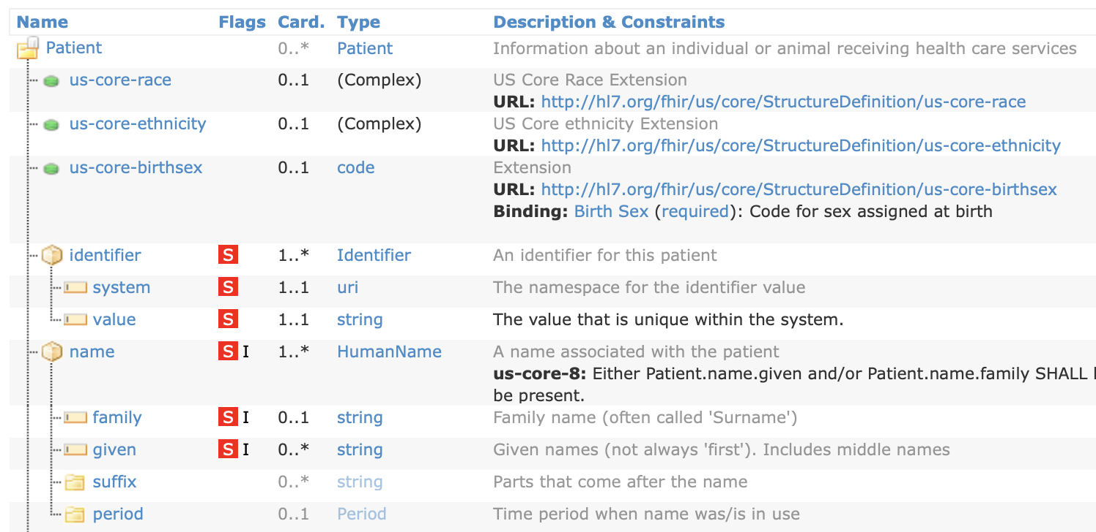
Example US Core Patient Profile
45

Slide 46
Example US Core Patient Profile… continued
46

Slide 47
Example US Core Patient Profile… continued part 2
47

Slide 48



FHIR® Implementation Guides
FHIR® Implementation Guides support specific use cases
Implementation Guides both restrict and extend APIs, resources, and terminologies
The Product of FHIR® Accelerators
There are currently 205 FHIR® Implementation Guides registered with HL7
Vulcan focuses on connecting clinical research and healthcare, including the collection of EHR data for prospective clinical research.
mCode focuses on collecting oncology data in the EHR for treatment, care coordination, and research.
US Core focuses on patient and provider access to ONC’s U.S. Core Data for Interoperability (USCDI).
48

Slide 49
Using FHIR® With Other Systems
49

Slide 50



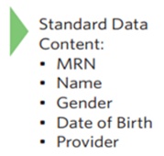
Example FHIR® Resource - JSON
{
"resourceType": "Patient"
"id": "patient1",
"meta": {
"versionId": "v2"
},
"text": {
"status": "generated",
"div": "<p>Henry Levin the 7th</p>"
},
"extension": [
{
"url": "http://hl7.org/fhir/StructureDefinition/patient-birthTime",
"valueDateTime": "1932-09-24T14:35:45-05:00"
}
],
"identifier": [{
"use": "usual",
"system": "http://acme.org/identifiers/mrn",
"value": "12345"
}],
"active": true,
"name": [{
"family": [ "Levin“ ],
"given": [ "Henry" ]
}],
"gender": "male",
"birthDate": "1932-09-24",
"managingOrganization": {
"reference": "Organization/123xyz",
"display": "Good Health Clinic"
}
}
50

Slide 51

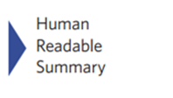

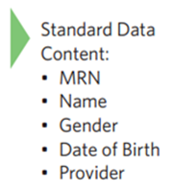
Example FHIR® Resource - XML
51

Slide 52
FHIR® uses REpresentational State Transfer (REST)
Uses the same technology as web browsers and servers: Hyper Text Transfer Protocol (HTTP)
URL: The address you are sending the request: e.g., https://someserver/fhir/Patient
Method: Four basic operations (CRUD)
POST: Create – Used to add data
GET: Read – Used to access data (including searches)
PUT: Update – Used to update existing data
DELETE: Delete – Used to delete data
HTTP Headers: A listing that indicates what type of data (e.g., JSON, XML) is being requested (Example: Accept: application/fhir+json)
Body: The payload of data being sent
52

Slide 53
Get a Patient…
RESPONSE
Status 200 OK
Content-Type: application/fhir+json
{
"id": "2679766",
"resourceType": "Patient",
"meta": {
"versionId": "1",
"lastUpdated": "2021-11-10T21:30:22.085+00:00”
},
"name": [ {
"use": "official",
"family": "Matos876",
"given": [ "Arturo47" ],
"prefix": [ "Mr." ]
} ],
"gender": "male",
"birthDate": "1956-02-21"
}
REQUEST
GET http://hapi.fhir.org/baseR4/
Patient/
2679766
53

Slide 54

SMART
Project run out of Boston Children's Hospital Computational Health Informatics Program
SMART on FHIR® (OAuth/OpenID Connect)
CDS Hooks
Bulk Data (including backend services auth)
SMART Health Cards (verifiable clinical information)
54

Slide 55

SMART: Substitutable Medical Applications, Reusable Technologies
SMART on FHIR® provides a way for applications (apps) developed by third parties to connect to and access information from Electronic Health Records (EHR) with the assurance of adequate security to protect personal data
Based on OAuth 2.0 and Open ID Connect, both established internet security standards
Decouples EHR data from app builders, allowing greater innovation through substitutable apps
Led by team out of Boston Children’s Hospital and funded by ONC
Multiple Launch Types
Standalone
Enables patient access by opening up data to apps
EHR Launch
Open within EHR
Instead of buying new features or waiting for monolithic EHR system to upgrade, you can integrate and display multiple apps within the EHR
55

Slide 56
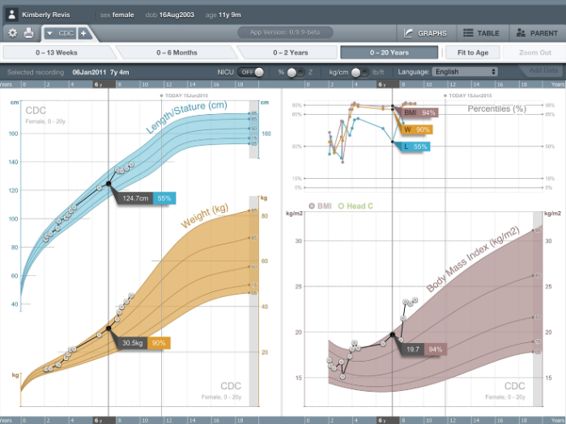
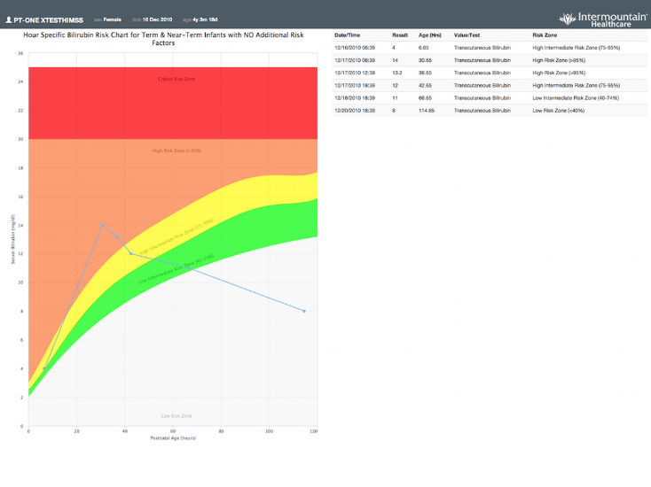
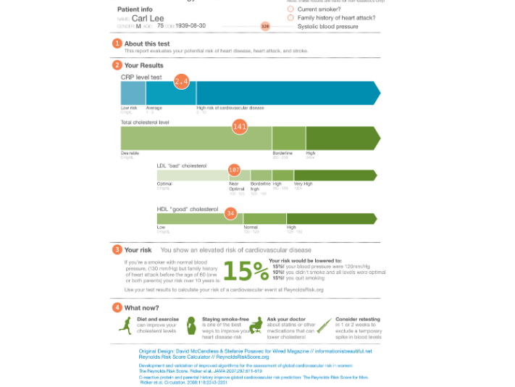
EHR as a Platform
Apps
API defined by SMART on FHIR®
User Management, Patient management, Documentation, Billing, Workflow, Orders, Legal, Regulatory, Data persistence
EHR
Cerner, EPIC, Allscripts, Meditech, McKesson, athenahealth, CPSI, Medhost, etc
56

Slide 57

Summary… part 2
FHIR’s basic building blocks are “Resources”
Examples: Patient, Observation, Condition
Resources define data elements names and types
Basic types like “integer” or “free text”
Terminology bindings
Implementation Guides define how FHIR is used for a specific use case
Adds constraints (e.g., required elements, specific terminology allowed)
Adds extensions to support data elements not covered by base FHIR
You can make your own IG!
FHIR® uses standard web technology for:
Data encoding: JSON and XML
Communication: REST
Integration with other systems via SMART technology
More information: https://purl.org/fhir-for-research/web

